Slide 1
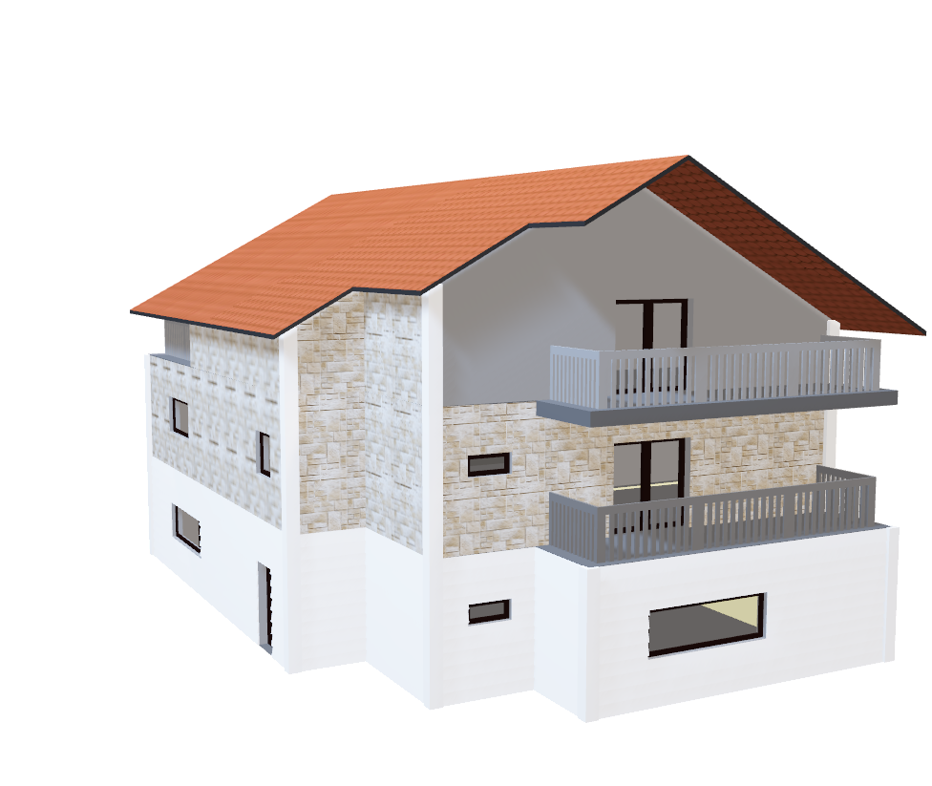
Home Mortgage NewJersey-2017 Statistical Analysis Using R
Sakshi Jaiswal
DS-540 Project

Slide 2
What is HMDA?
HMDA data are the most comprehensive source of publicly available information on the U.S. mortgage market.
The Home Mortgage Disclosure Act (HMDA) requires many financial institutions to maintain, report, and publicly disclose loan-level information about mortgages.
This dataset consist of around ~360K records and 78 columns .
Source https://www.consumerfinance.gov/data-research/hmda/

Slide 3
The dataset provided can be grouped into following the categories :
Location describes the State, County and census tract of the property(The number of the census tract for the property is only unique when combined with the state and county codes). The Metropolitan Statistical Area/Metropolitan Division (MSA/MD) the property is located in.
Property Type include One-to-four family dwelling, Manufactured housing and Multifamily dwelling.
Loan describes the action taken on the Loan, purpose of the Loan , Type of the loan ,Loan’s lien status.
Lender describes the lender associated with the loan and the Federal agency associated with the loan.
Applicant describes the demographic information for the applicants and the co-applicants. This has the applicant sex , co- applicant sex , applicant race and ethnicity, co- applicant race and ethnicity.
The Metropolitan Statistical Area/ Metropolitian Division (MSA/MD) the property is located in.

Slide 4
Problem Statement -
To Analyze Action taken on loan origination.
To Analyze of Loan Agency associated with Loan originated.
To Analyze of Loan Origination using ethnicity.
To Analyze of Loan Approval based on county.
To Analyze loan Origination Gender wise .
Modelling using Multiple Regression .

Slide 5
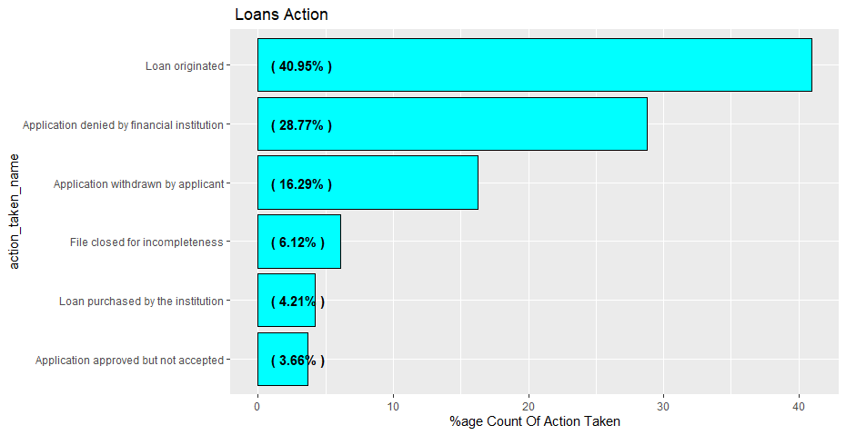
Loan Originated Analysis : If customer want to buy a home but doesn’t have the money to pay for it in cash, so she applies for a loan at her bank and other information the bank needs to make a decision about whether or not to lend to her, and the terms of the loan. The bank reviews Customer’s application, decides that she/he meets their criteria, and she/he gets approved. Once all the papers are signed, Customers closes the loan… or in mortgage-speak, the loan is “originated.”.
Therefore the last stage of the loan is Loan Origination.
More than 40% of the loans are loan originated.

Slide 6
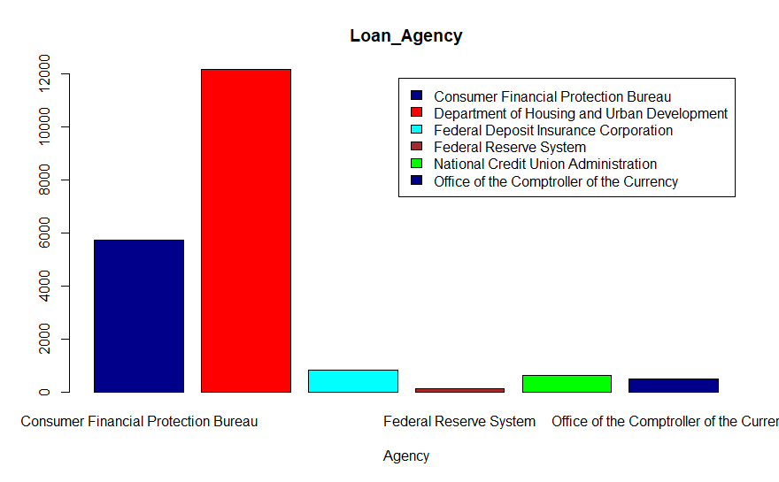
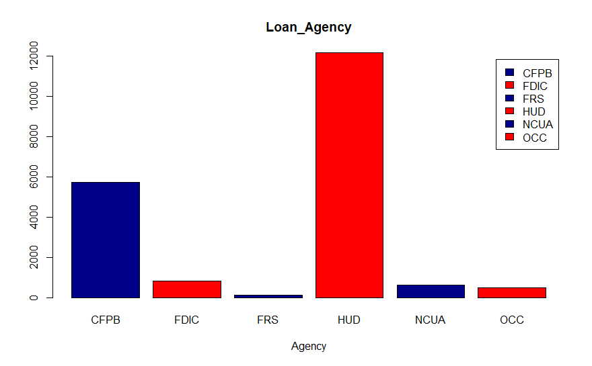
Loan Agency associated with Loan Origination:
Most of the people taking Loan from HUD agency.

Slide 7
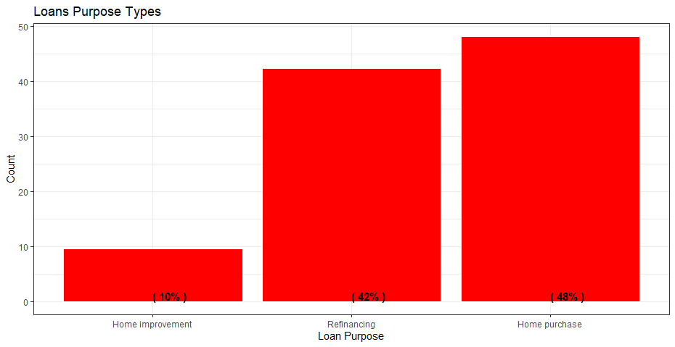
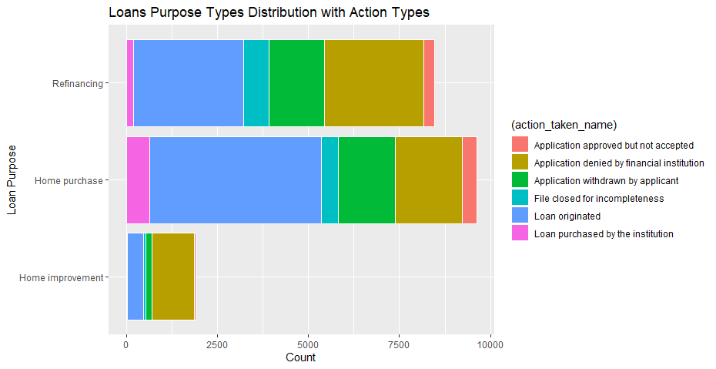
Loan Purpose Types :We investigate the different loan Purpose Types associated with the loans.
Loan Purpose Types distribution
Home Purchase and Refinancing are the major Loan Purpose types.

Slide 8
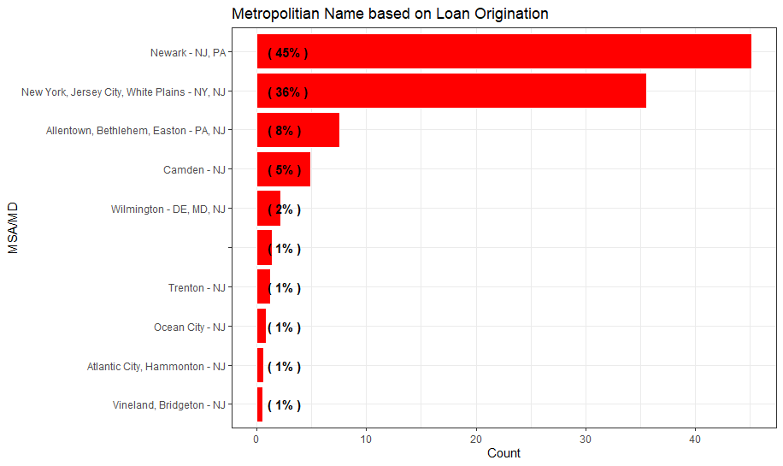
Metropolitan Areas: Here are some metropolitan in New jersey like Newark and Jersey City where loan origination % is more than other Metro.

Slide 9
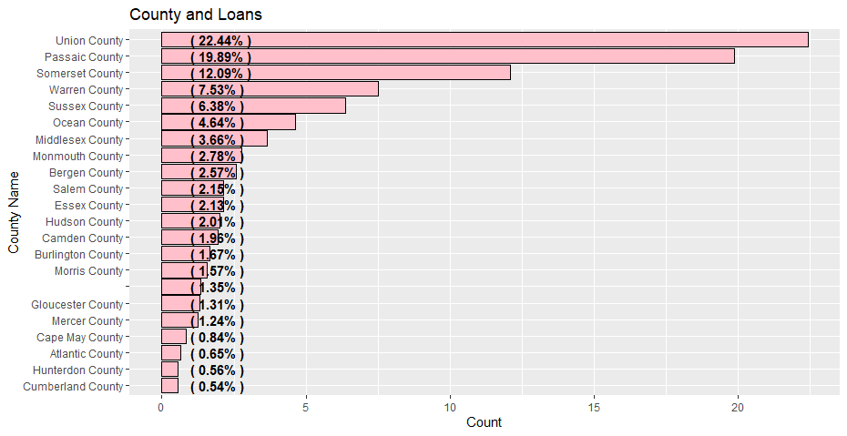
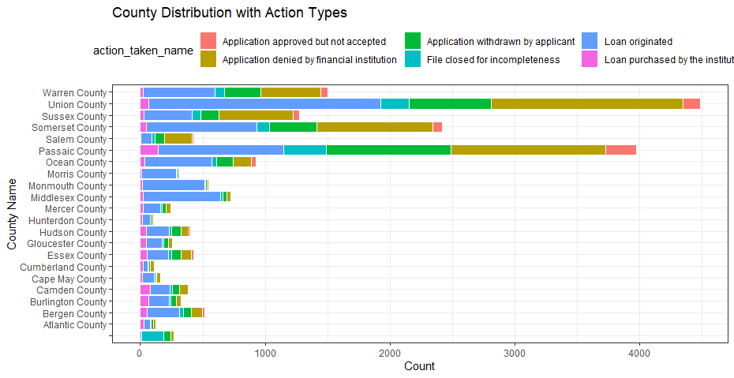
County types:
We investigate the different County Types associated with the loans.
Top 10 Counties distribution
We display the Top 10 Counties associated with loans.
Union County have 22.44% loan originated.

Slide 10
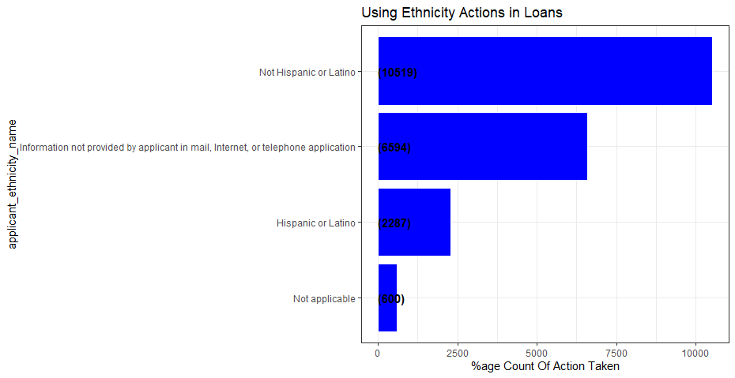
Ethnic groups: Here, we explore the various ethnic groups which have been associated with the loan origination process.
The following bar graph shows the distribution of the various ethnic communities.
The Not Hispanic or Latino ethnic community applies for the largest percentage of the loans.

Slide 11
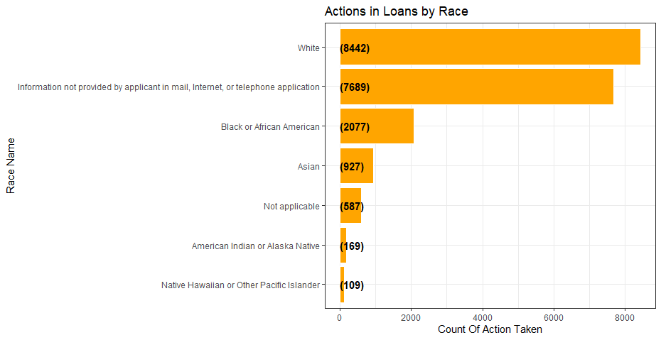
Loan Origination according Race : We explore the various races which have been associated with the loan origination process.
The White community applies for the largest percentage of loans.

Slide 12
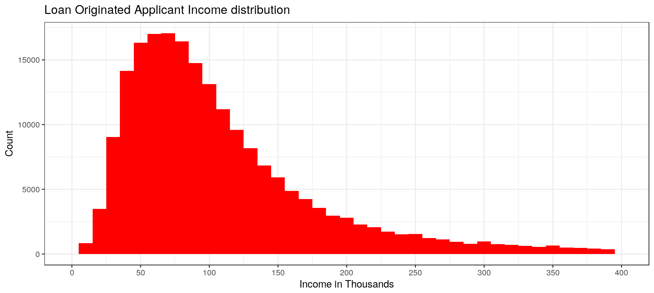
Applicant Income Distribution:
We observe that MOST of the loans which are originated have applicants with income around Sixty Thousand to Seventy Five thousand dollars.
We observe that MOST of the loans which are originated have applicants with income around Sixty Thousand to Seventy Five thousand dollars.

Slide 13
Statistical Analysis
For statistical Analysis I used Multiple Regression:
Best Model :
model4<-lm(train$lien_status~train$msamd+train$action_taken+train$applicant_ethnicity+
train$applicant_income_000s+train$applicant_race_1+train$co_applicant_ethnicity+
train$co_applicant_sex +train$county_code+train$hoepa_status)

Slide 14
Conclusion
Loan Origination Based on combination of following features:
Lien Status is the most important feature since it is the first feature used to take the decision.
Purchase Status is the Second feature used for modelling
Loan Purchase , Loan Type , County and Loan Amount MSA/MD+ Ethnicity, Applicant ethnicity, Applicant Race

